Slide 1
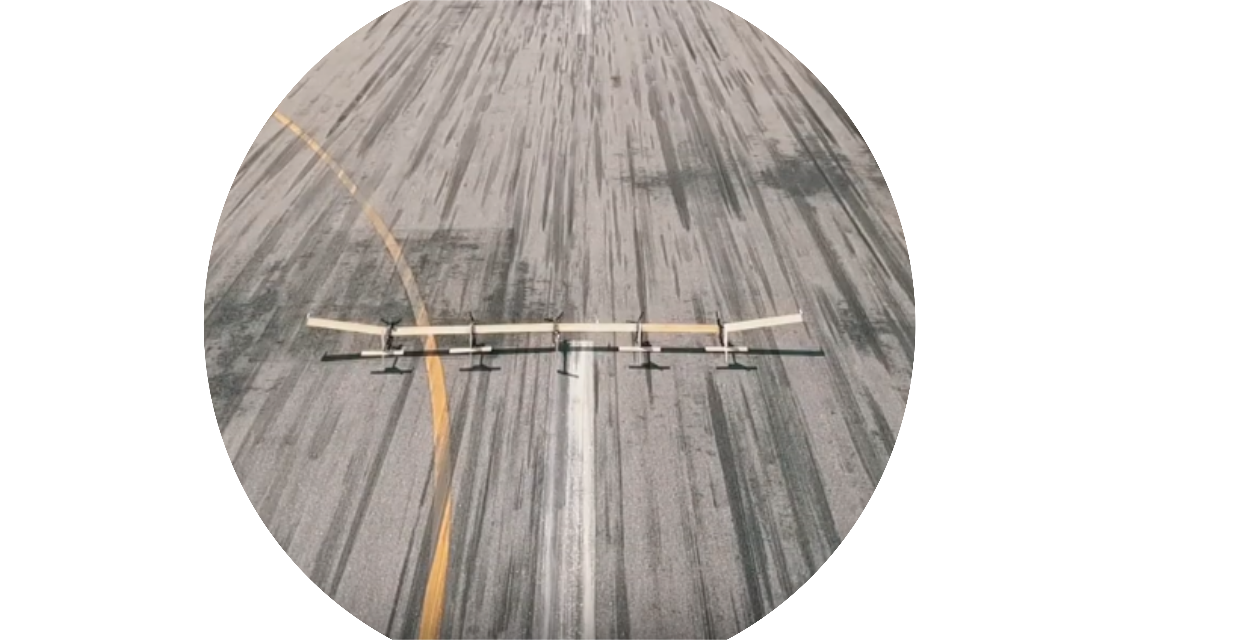
Aeroelastic Analysis and Optimization of a Highly Flexible Aircraft and Application at X-HALE-BR
Francisco Arthur Bonfim Azevedo
02/04/2020

Slide 2
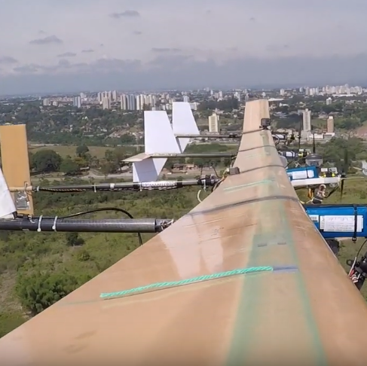
The Aeroelastic Analysis

Slide 3
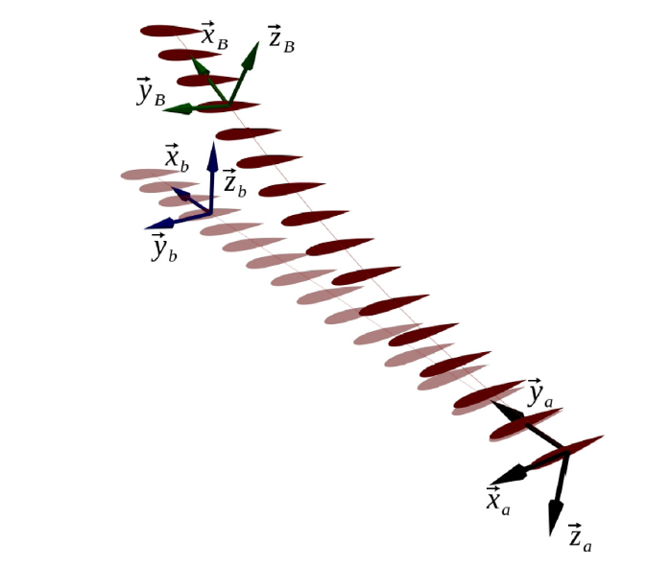
The Aeroelastic Analysis
First of all, the aeroelastic model must be made
As the literature[1] [2] [3] [4] [5] previews, the model is a nonlinear coupled one
After a representative model is obtained, it must be validated and, if necessary, simplified to make it possible to be solved in a viable time by the computer
The validation may be done with real data and comparison with the flight dynamics model [6] [7].
The model will be made in Python 3, using the toolbox CalculiX [8]

Slide 4
The Aeroelastic Optimization

Slide 5
The Aeroelastic Optimization
This research proposes an aeroelastic optimization for the X-HALE-BR
The optimization may not suppress the flexible characteristics of the aircraft
With the aeroelastical model, the toolbox openMDAO [9] will be used to optimize characteristics and parameters the aircraft, looking for a configuration that minimizes the vibration and the flutter

Slide 6
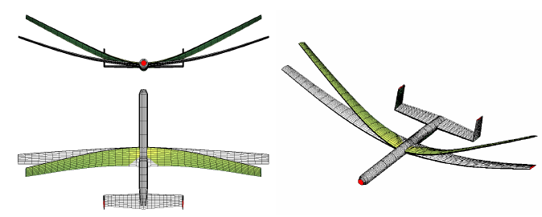

Previous works
Previous works that may used as the basis for the analysis may be find in [1] and [7] with a large quantity of analysis and data

Slide 7
Future works
To improve the aeroelastic properties of the aircraft, a active flutter control system will be proposed, using optimal control with openMDAO, as may be seem in [10] and [11]

Slide 8
Bibliography
Su, Weihua. Coupled Nonlinear Aeroelasticity and Flight Dynamics of Fully Flexible Aircraft. Diss. 2008.
Nam, C., Y. Kim, and T. A. Weisshaar. "Computational Aids in Aeroservoelastic Analysis Using MATLAB." (2001).
Dowell, Earl H. A modern course in aeroelasticity. Eds. Howard C. Curtiss, Robert H. Scanlan, and Fernando Sisto. Vol. 3. Dordrecht, The Netherlands: Kluwer academic publishers, 1989.
Wright, Jan Robert, and Jonathan Edward Cooper. Introduction to aircraft aeroelasticity and loads. Vol. 20. John Wiley & Sons, 2008.
Brandao, Maurıcio Pazini. "Fundamentos da dinâmica de estruturas." PROPESA, CTA, São José dos Campos, SP (1996).
Patil, Mayuresh J., and Dewey H. Hodges. "Flight dynamics of highly flexible flying wings." Journal of Aircraft 43.6 (2006): 1790-1799.
Ribeiro, F., et al. "Aeroflex: a toolbox for studying the flight dynamics of highly flexible airplanes." Congresso Nacional de Engenharia Mecânica. 2012.
Kirsch, Bertrand, et al. "Tightly coupled aeroelastic model implementation dedicated to fast aeroelastic tailoring optimisation of high aspect ratio composite wing." Journal of Fluids and Structures 94 (2020): 102930.
Gray, Justin, Kenneth Moore, and Bret Naylor. "OpenMDAO: An open source framework for multidisciplinary analysis and optimization." 13th AIAA/ISSMO Multidisciplinary Analysis Optimization Conference. 2010.
Roger, Kenneth L., Garold E. Hodges, and Larry Felt. "Active flutter suppression-a flight test demonstration." Journal of Aircraft 12.6 (1975): 551-556.
Thompson, Glenn O., and Gerald J. Kass. "Active flutter suppression-an emerging technology." Journal of Aircraft 9.3 (1972): 230-235.

Slide 9
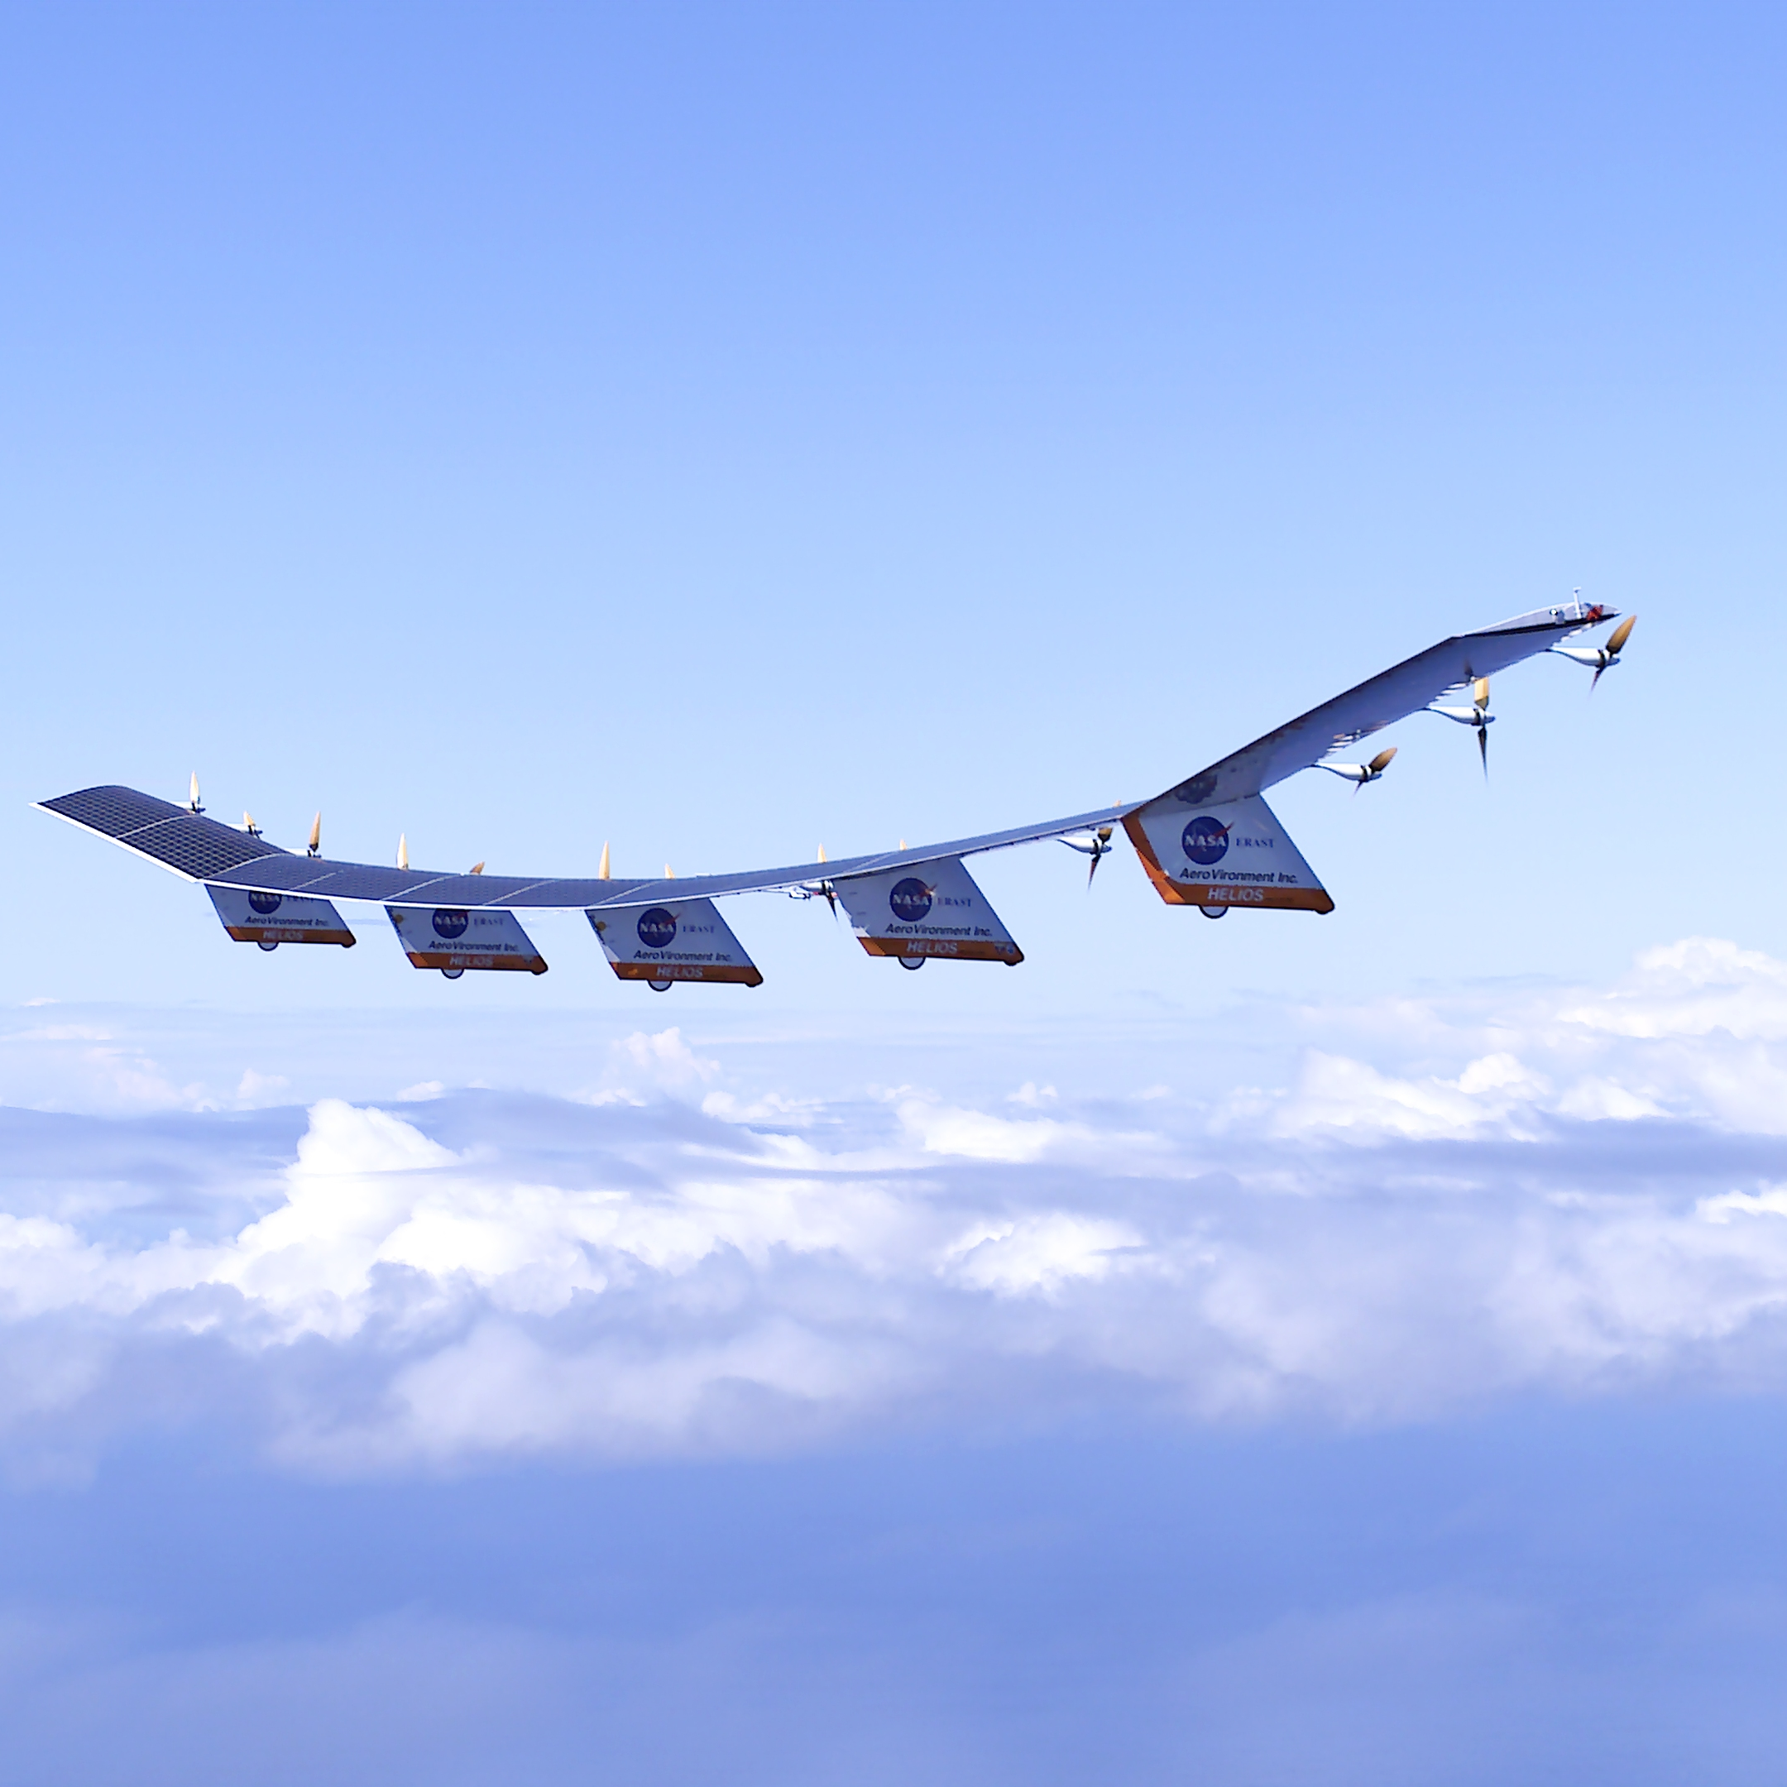
THANK YOU!

